Slide 1
Cross Paradigm Interoperability Implementation Guide for Immunization: X Paradigm
Brief Profile Proposal for 2012/13
presented to the
Patient Care Coordination (PCC)
Planning Committee
<Alean Kirnak et al>
<17-Oct-2012>
Notes:
Web site - http://hssp.wikispaces.com/Cross+Paradigm+Interoperability+Implementation+Guide+for+Immunization

Slide 2
The Problem
The X Paradigm project is meant to provide guidance in creating deployments where many systems, new and legacy, speaking different standard protocols, must interoperate to satisfy one healthcare domain.
The immunizations domain was chosen due to its relative simplicity, existing infrastructure, and the background of some authors. The HL7 Service-Aware Interoperability Framework (SAIF) provides the theoretical and standards framework for approaching the project.
The X Paradigm Informative Ballot is an early draft released for HL7 ballot for purposes of collecting broad review and comment. The project is not complete; it is informative at this early stage.
Notes:
X Paradigm Project Website: http://hssp.wikispaces.com/Cross+Paradigm+Interoperability+Implementation+Guide+for+Immunization
Informative Ballot: http://hssp.wikispaces.com/file/view/X+Paradigm+Informative+Ballot+072212.docx

Slide 3
The Approach
Artifact cross reference, standards xref created
Layered Service Architecture researched
Storyboard narratives/Use Cases researched
Common Informational Model researched

Slide 4
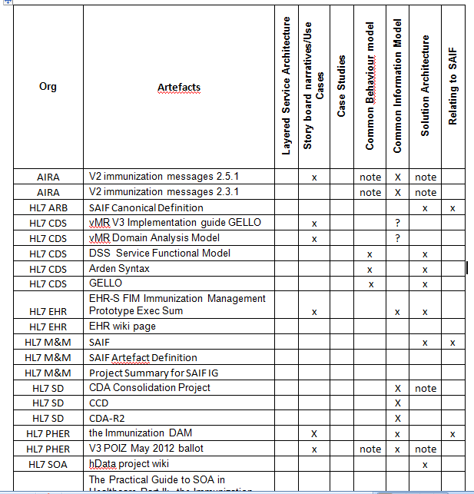
Artifact Cross Reference
...continued, and links to specs in the spreadsheet.
Notes:
http://hssp.wikispaces.com/file/view/Artefacts.xlsx

Slide 5
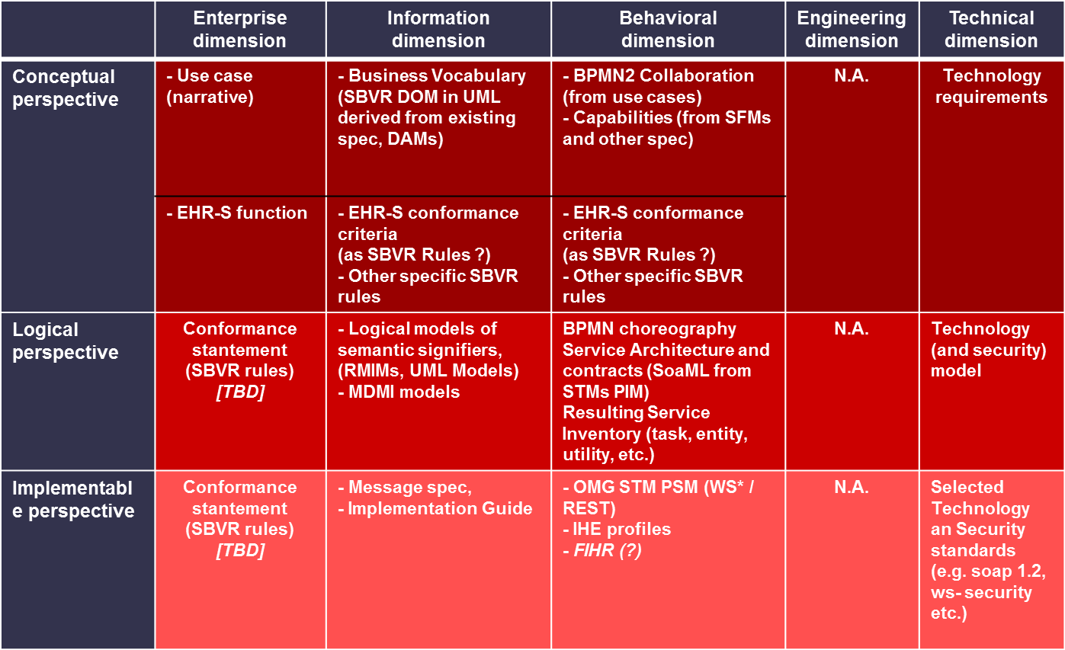
Layered Service Architecture
X Paradigm artifacts mapped in the HL7 SOA-Aware Interoperability Framework (SAIF) ISM:
Notes:
http://hssp.wikispaces.com/file/view/X+Paradigm+Informative+Ballot+072212.docx
HL7 SAIF: http://wiki.hl7.org/index.php?title=Product_SAIF

Slide 6
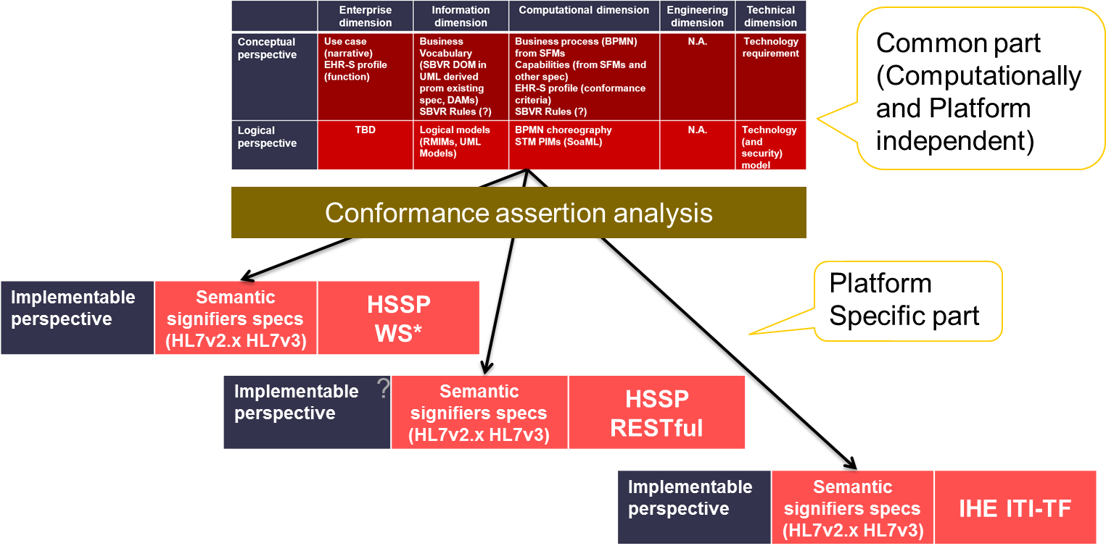
Layered Service Architecture
X Paradigm implementation perspective example:
Notes:
http://hssp.wikispaces.com/file/view/X+Paradigm+Informative+Ballot+072212.docx

Slide 7
Storyboards/Use Cases/Services
X Paradigm Use Case Analysis Overview
X Paradigm concluded that the Immunization Domain Analysis Model (IZ DAM) contained the most inclusive and recent collection of Storyboards and Use Cases.
Storyboard narrative Interactions were cross-referenced with Use Cases.
Use Cases were analyzed and mapped to existing HSSP Service Specifications. Gaps were identified for Manage Vaccine Inventory and Manage Reports.
Notes:
Use Case Analysys Overview: http://hssp.wikispaces.com/Use+Cases
IZ DAM: http://www.hl7.org/implement/standards/product_brief.cfm?product_id=274
IZ DAM PDF: http://www.hl7.org/documentcenter/private/standards/v3/V3DAM_IZ_R1_INFORM_2012MAY.pdf
Storyboards cross-referenced with Use Cases: http://hssp.wikispaces.com/file/view/Use+Case+Mapping+2nd+pass.xlsx
Use cases mapped to HSSP Service Specs: http://hssp.wikispaces.com/file/view/Use+Cases+and+revised+service+stack.xlsx

Slide 8
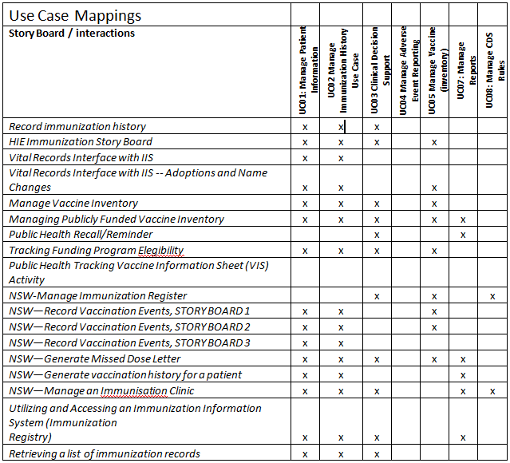
Use Cases x Interactions
Notes:
http://hssp.wikispaces.com/file/view/X+Paradigm+Informative+Ballot+072212.docx

Slide 9
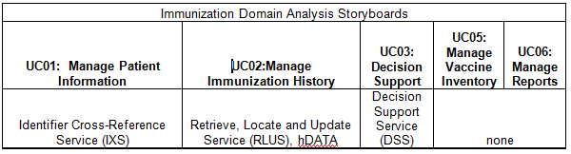
Use Cases x HSSP Services
Notes:
http://hssp.wikispaces.com/file/view/X+Paradigm+Informative+Ballot+072212.docx

Slide 10
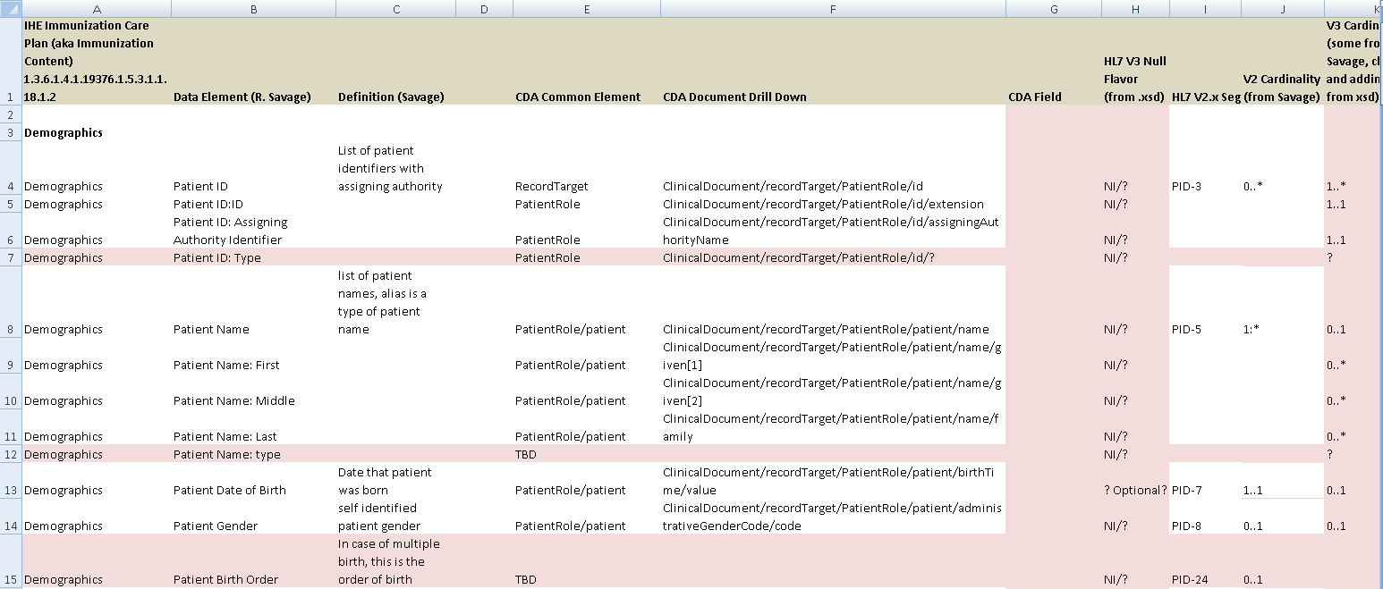
CIM V2.x x CDA Field Mappings
...continued...
Notes:
http://hssp.wikispaces.com/file/view/ImmunizationStandardsHarmonization_swp.xlsx

Slide 11
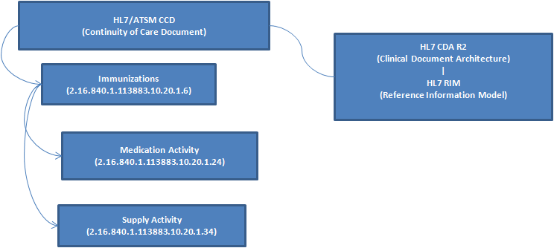
CIM HL7 CCD Templates
Notes:
Field mappings: http://hssp.wikispaces.com/file/view/ImmunizationStandardsHarmonization_swp.xlsx

Slide 12
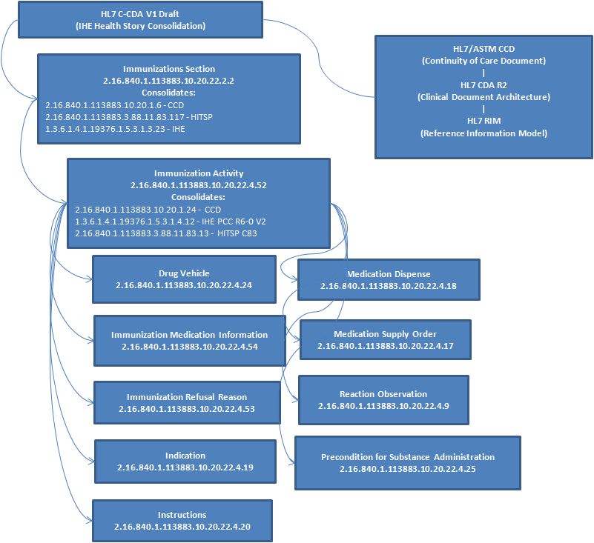
CIM HL7 C-CDA Templates
Notes:
http://hssp.wikispaces.com/file/view/ImmunizationStandardsHarmonization_swp.xlsx

Slide 13
Discussion/TBD
Simplicity is the goal, but hard to achieve in this domain
Impact of REST and open source software on EHR
TBD:
  Common Information Model: more std cross reference work, and the CIM TBD
  Common Behavioral Model: TBD
  Solution Architecture: TBD
  Case Studies: Sites identified, and TBD
Alean Kirnak is the driving force behind X Paradigm

